Slide 1
2D Game Engine Development
Have fun!!!
CHEN ZHENGANG
ZHANG ZIYI
GROUP 3
JIANG XINYUAN
Notes:
预览及使用此模板前先下载英文Segoe Script、中文新蒂小丸子小学版字体，预览效果会更加美观！

Slide 2
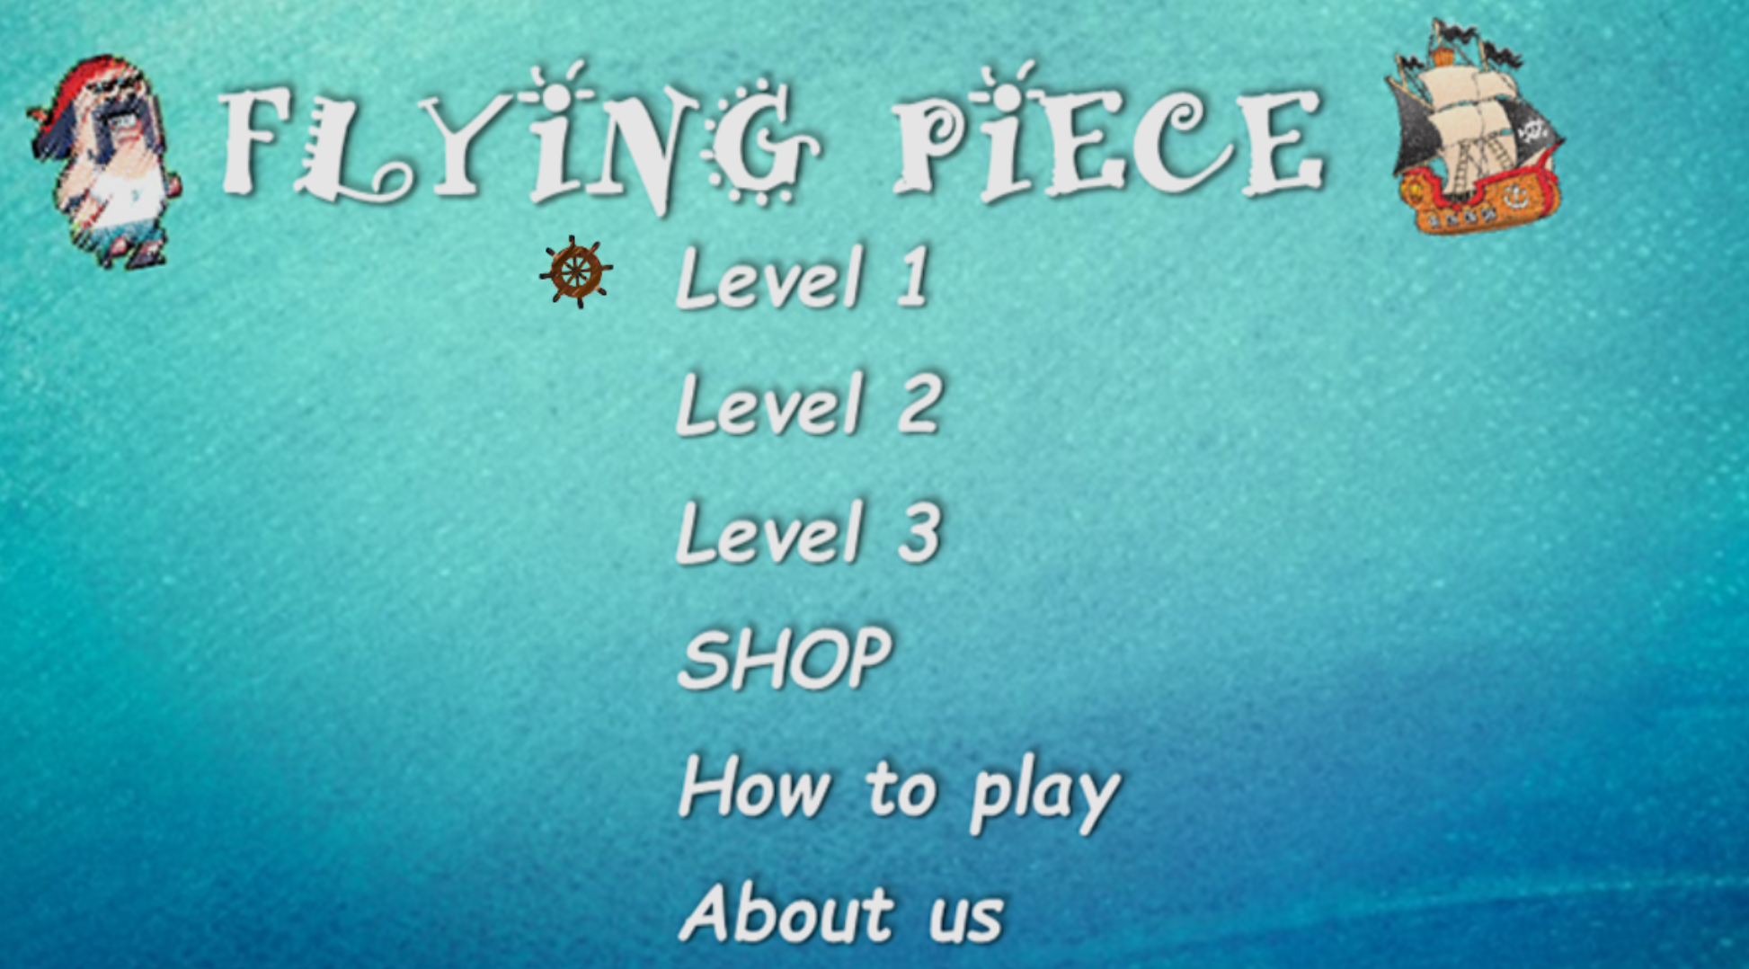
Main menu

Slide 3
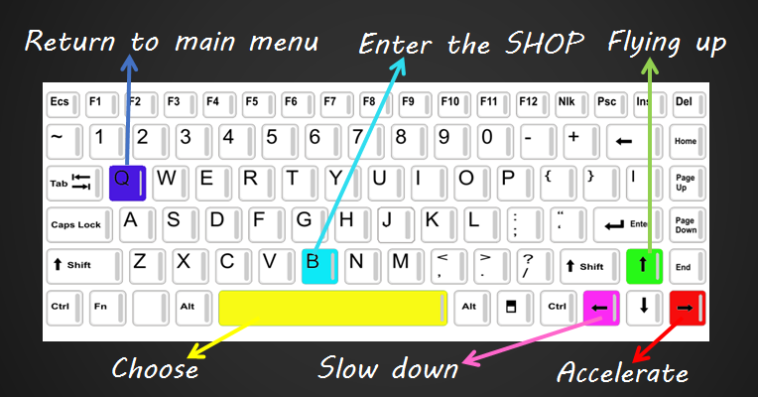
How to play
Notes:
预览及使用此模板前先下载英文Segoe Script、中文新蒂小丸子小学版字体，预览效果会更加美观！

Slide 4
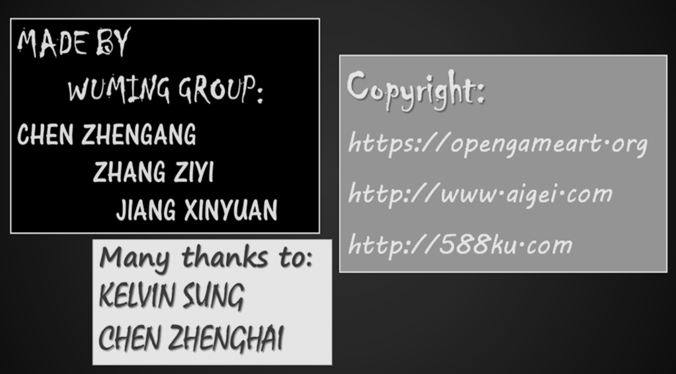
About us
Notes:
预览及使用此模板前先下载英文Segoe Script、中文新蒂小丸子小学版字体，预览效果会更加美观！

Slide 5
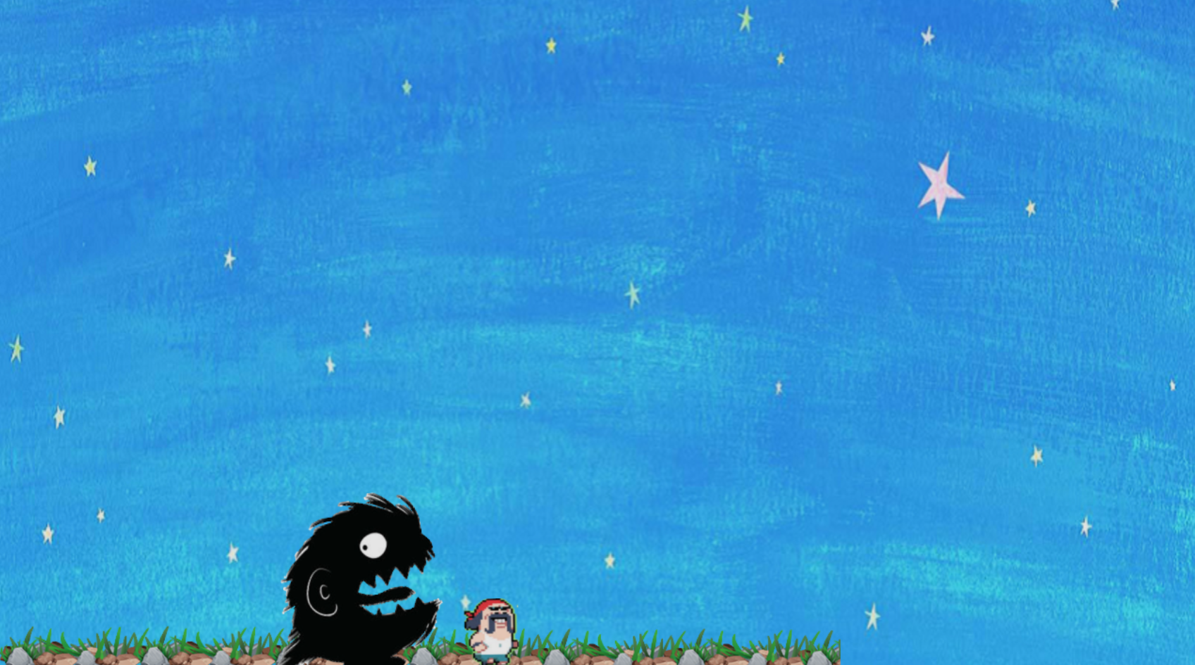
Level 1
A monster is chasing our hero And then the hero fly away…..

Slide 6
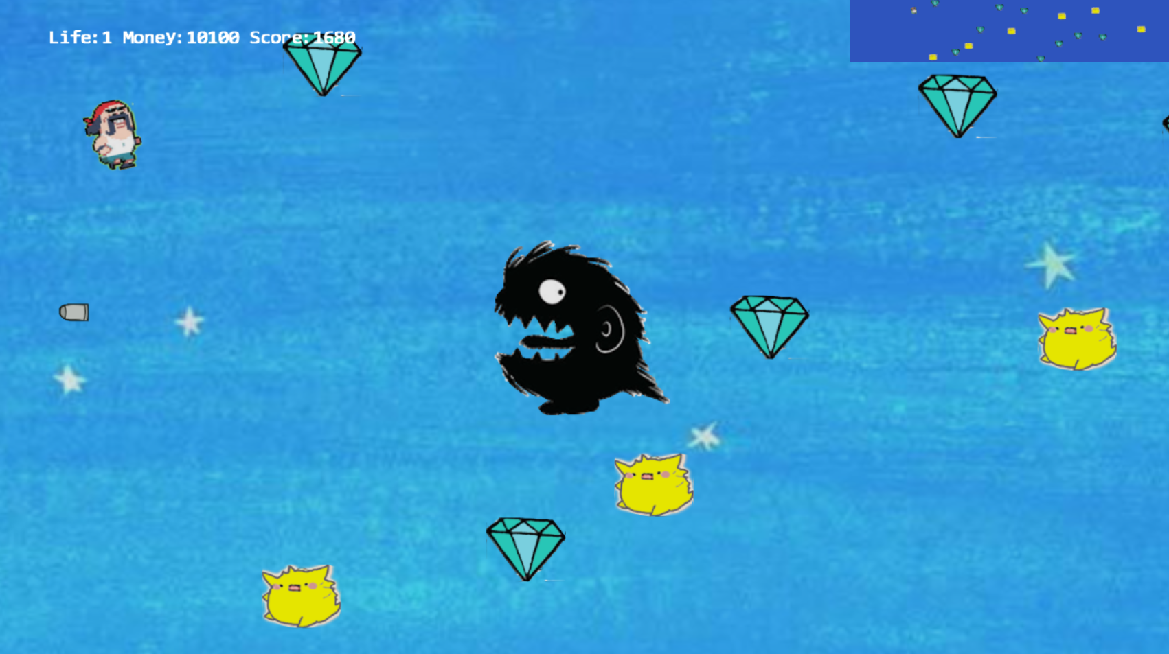
Level 1
Small monsters will stand in the way…..
Try to escape them and own your treasure.
The monster will shoot you…

Slide 7
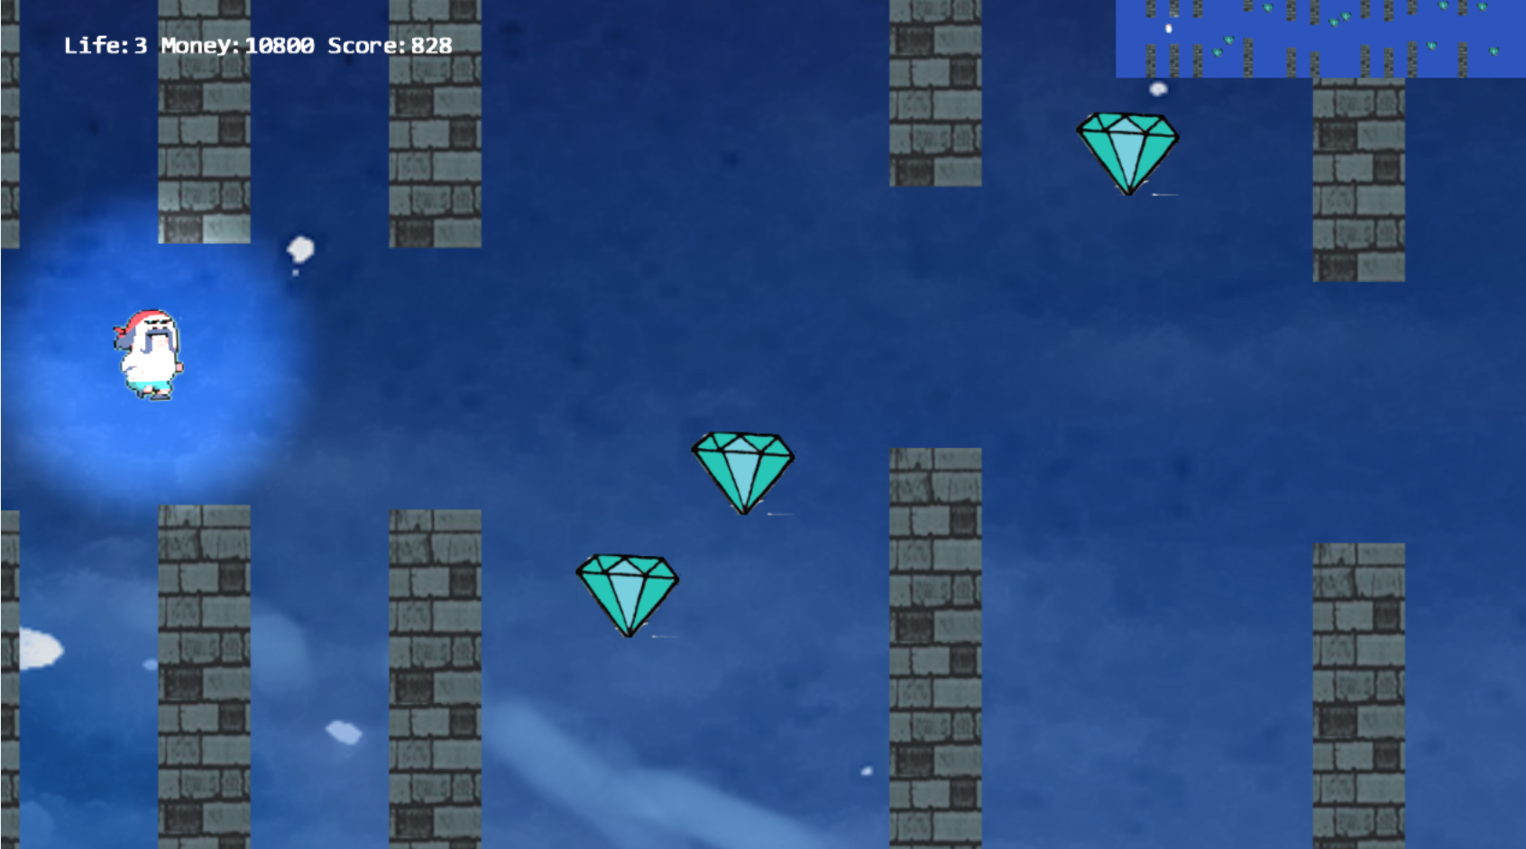
Level 2
A small panoramic camera
There are many stone pillars…

Slide 8
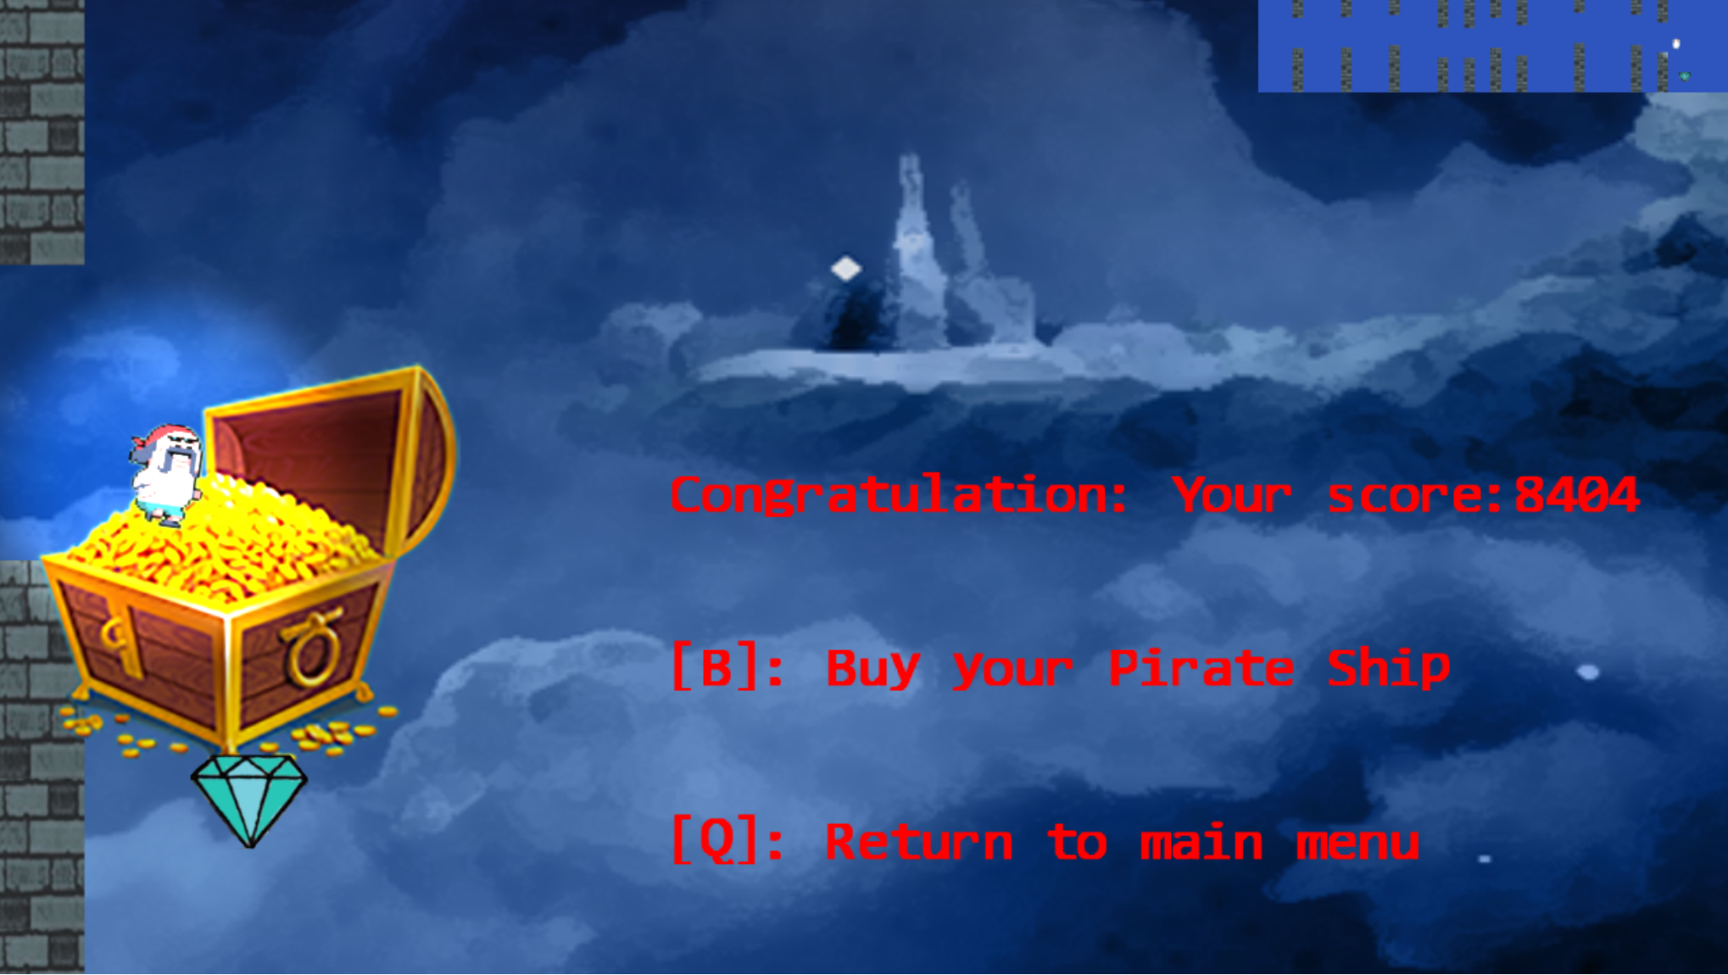
Level 2
A spot light following the hero.
treasure

Slide 9
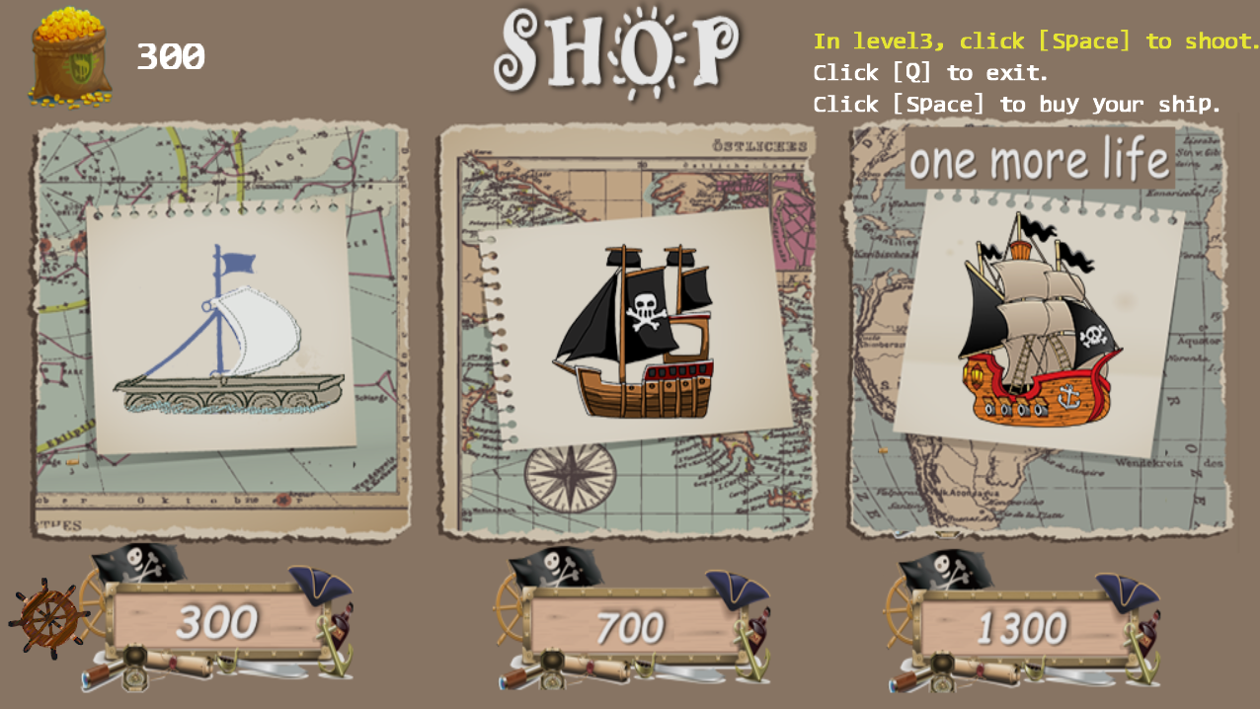
Only when you pass the level, you can own your money.

Slide 10
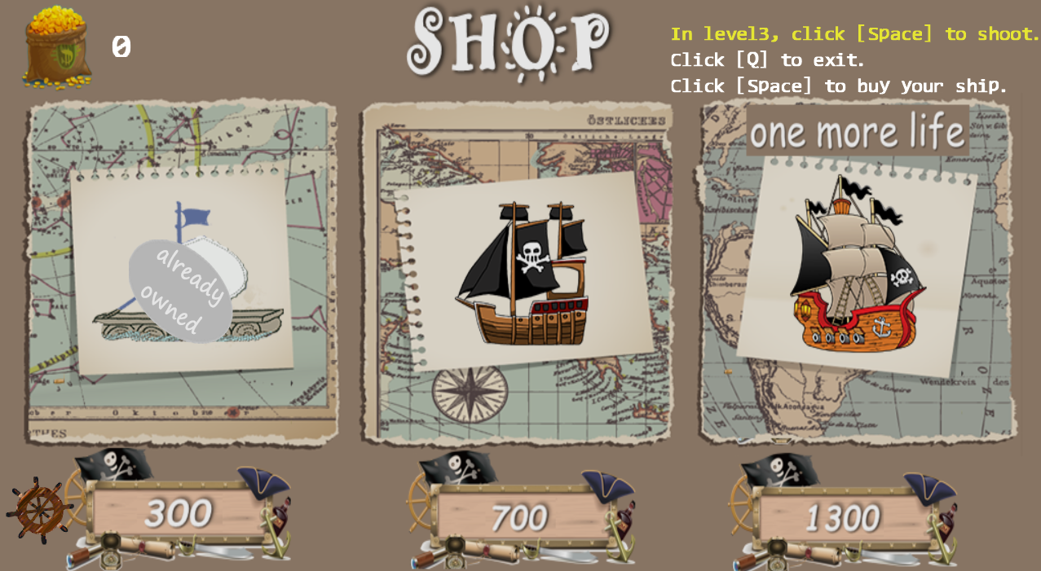
you can buy different ships,
but every different shape once

Slide 11
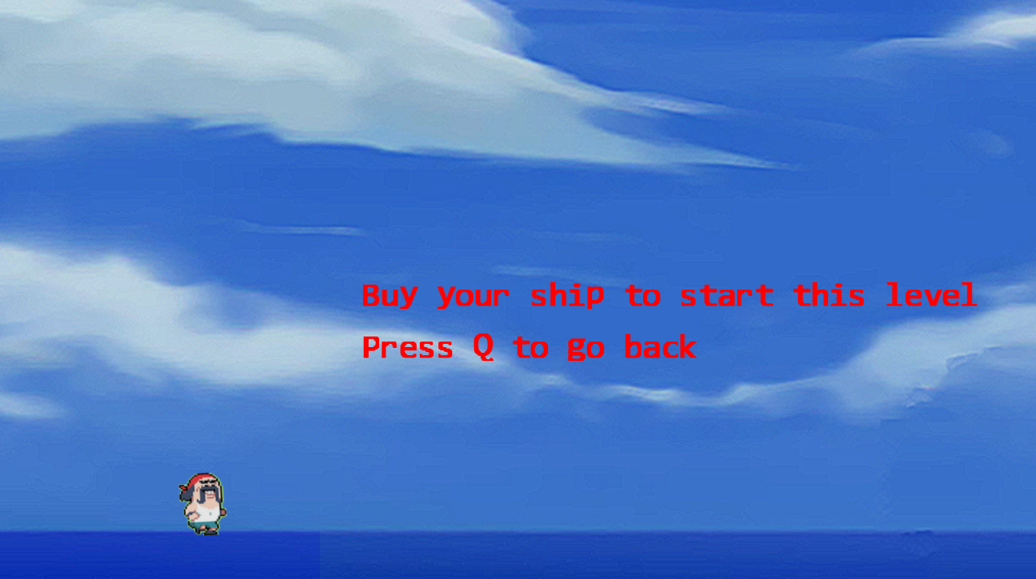
Level 3
If you don’t buy a ship,
it’s really a sad story…

Slide 12
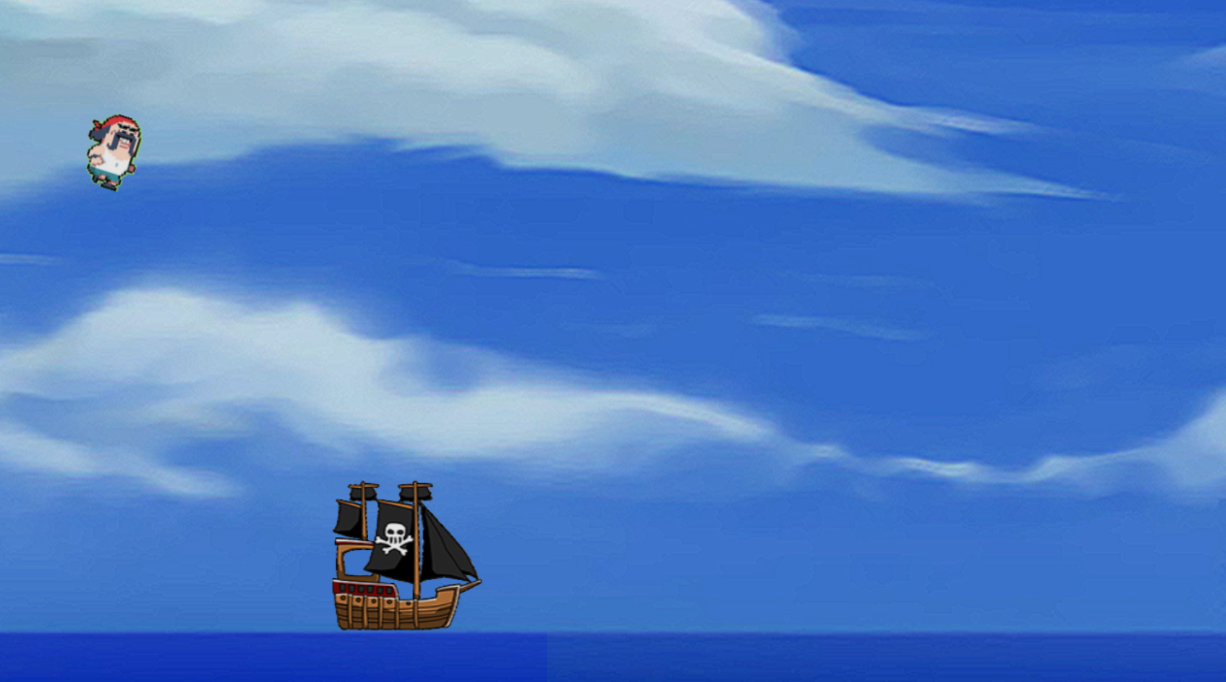
Level 3
The ship you bought in the shop.(click space to choose)

Slide 13
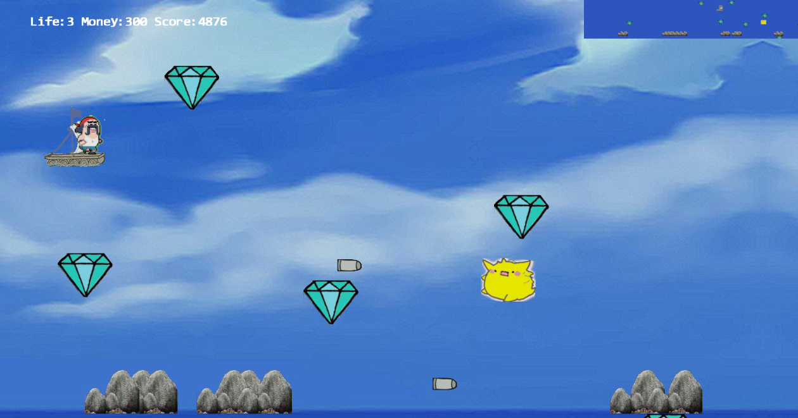
Level 3
You can shoot the monsters!

Slide 14
Technical Requirements
Different Scenes
- MyGame(Main menu)
-Level1
-Level2
-SHOP
-Level3
-How to play
-About us
Gamera View
-Main View
-Panoramic View
Game objects
-Hero
-Monster
-Coin
-Ship
-Different Obstacles
-Treasture

Slide 15
Technical Requirements
Behavior
-Hero different Behavior(Free fall and Jump)
-Monster different Behavior(Chase and Shoot)
-Collision with Hero and Monster/Obstacle/Coins
-Bullet in level1 has a pseudo-autonomous behavior: chase Hero
-Bullet in level3 hit the Monster

Slide 16
Technical Requirements
Lighting
-Spot light:
The Hero in level2 will have a spotlight
-LightRenderable：
The Column
The Treasure
The Bg
Echo of game status
-Background music
-Select
-Monster
-Jump
-Collision
-Get diamonds
-SHOP

Slide 17
THANK
YOU

